Slide 1

OBJECTIVE :-
Vrinda store wants to create an annual sales report for 2022. So that Vrinda can understand their and grow their customers in 2023.

Slide 2
SAMPLE QUESTIONS
Compare the sales and orders using single chart.
Which month got the highest sales and orders?
Who purchased more - men or women in 2022?
What are different order status inn 2022?
List the top states contributing to the sales?
Relation between age and gender based on number of orders? Which channel is contributing to the maximum sales?
Highest selling category?, Etc.

Slide 3
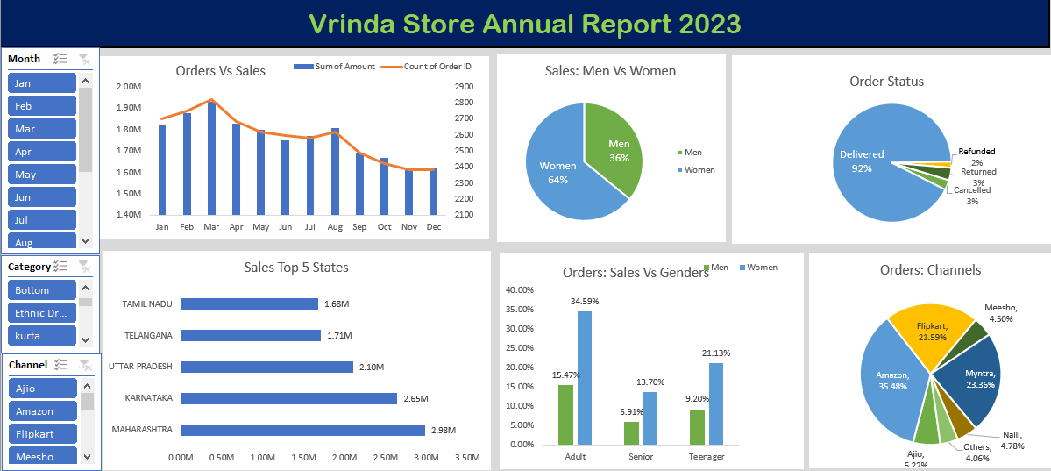

Slide 4
SAMPLE INISIGHTS
Women are more likely to buy compared to men (~ 65%)
Maharashtra, Karnatka and Uttar Pradesh are the top 3 States (~35 %)
Adult age group (39-40 yrs.) is max contributing (~50%)
Amazon, Flipkart and Myntra channels are max contributing (~80%)
Final Conclusion to improve Vrinda store Sales :
Target women customers of age (39-40 yrs.) living in Maharashtra, Karnatka and Uttar Pradesh by showing ads/coupons available on Amazon, Flipkart and Myntra.

Slide 5
THANKYOU

